Slide 1
SDMX Information Model
Rabih El Habta
First National Training on the Use of SDMX in SDG Reporting
28-30 August 2023

Slide 2
Statistical Data and Metadata Exchange (SDMX)
What is SDMX?
SDMX is an ISO standard designed to describe statistical data and metadata, normalize their exchange, and improve their efficient sharing across statistical and similar organizations.
SDMX sets statistical and technical standards to facilitate the exchange of statistical data and metadata using modern information technology.
Why SDMX is important for SDGs?
SDMX enables the automation of SDG data and metadata exchange between two or more entities.
SDMX also facilitates the validation, dissemination, and reporting of SDG data.
Notes:
SDMX enables the automation of data and metadata exchange by setting the statistical standards i.e., normalization, it also facilitates the validation of the data.
i.e., if the data follows the international standards, this is very important for SDGs as well as it will validate the allowed disaggregation.

Slide 3

Figures vs data
Number
Tourism establishments
Italy
Annual data
Figures by themselves are meaningless.
For data to be usable, it must be properly described. The descriptions let users know what the data actually represents.
2529
Notes:
Any statistical table is a set of observations or measures.
But the observation itself means nothing.
We need metadata to identify the figure such as the Tourism establishments, the unit, the country, the frequency, the time…
This information will be called structural metadata.
We can now introduce our fist SDMX object: the Concept.
The concept is a label describing the data.
It has an ID, a name and description in several languages.

Slide 4
Developing a Data Model for Data Exchange
Data model is developed to provide descriptions for all relevant characteristics of the data to be exchanged
In SDMX, data model is represented by a Data Structure Definition (DSD).
To design a DSD, we first need to find concepts that identify and describe our data.

Slide 5
Concept
“Unit of thought created by a unique combination of characteristics”*
Each concept describes something about the data.
Concepts should express all relevant data characteristics.
* Source: SDMX Glossary

Slide 6
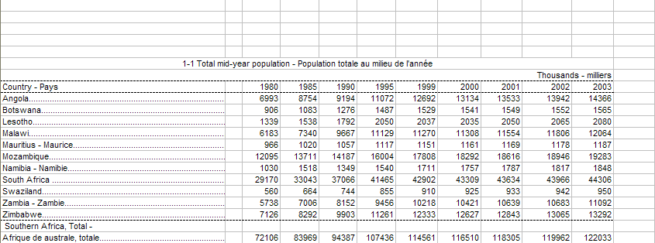
Identifying Concepts
Indicator
Time Period
Ref. Area
Unit Multiplier
Obs. Value

Slide 7
SDMX Concept Scheme
“Set of Concepts that are used in a Data Structure Definition or Metadata Structure Definition.”*
Concept scheme places concepts into a maintainable unit.
Concept name | Concept ID
Indicator | INDICATOR
Reference area | REF_AREA
Time period | TIME_PERIOD
Unit multiplier | UNIT_MULT
Observation value | OBS_VALUE
* Source: SDMX Glossary

Slide 8
Dimension
Which of the concepts are used to identify an observation?
  Indicator
  Reference area
  Time Period
When all 3 are known, we can unambiguously locate an observation in the table.
These are called dimensions.
  A dimension is similar in meaning to a database table’s primary key field.

Slide 9
Attribute
In our example, Unit Multiplier represents additional information about observations.
This concept is not used to identify a series or observation.
Such concepts are called attributes.
  Not to be confused with XML attributes!
  Similar to a database table’s non-primary key fields.

Slide 10
Primary Measure
Observation Value represents a concept that describes the actual values being transmitted.
In SDMX, such a concept is called Primary Measure.
Primary Measure is usually represented by concept with ID OBS_VALUE.

Slide 11
Dimension or Attribute?
Choosing the role of a concept has profound implications on the structure of data.
Concepts that identify data, should be made dimensions. Concepts that provide additional information about data, should be made attributes.
If a concept is a dimension, it is possible to have time series that are different only in the value of this concept.
  E.g. if Unit of Measure is a dimension, it is possible to have separate time series for “T” and “T/HA” or, more controversially, “KG” and “T”

Slide 12
Dimension or Attribute? (2)
Cambodia
Fixed and Mobile telephone subscriptions | 2013 | 20.6 million
Fixed and Mobile telephone subscriptions | 2012 | 19.7 million
Fixed and Mobile telephone subscriptions | 2013 | 140.9 per 100 pop.
Unit of measure as a dimension… (dimensions underlined)
Ref.Area | Indicator | Time Period | Unit | Unit Mult. | Obs. Value
Cambodia | Fixed and Mobile telephone subscriptions | 2013 | Number | Millions | 20.6
Cambodia | Fixed and Mobile telephone subscriptions | 2012 | Number | Millions | 19.7
Cambodia | Fixed and Mobile telephone subscriptions | 2013 | Per 100 pop. | Units | 140.9

Slide 13
Dimension or Attribute? (3)
Unit of measure as an attribute…
Violation!
Ref.Area | Indicator | Time Period | Unit | Unit Mult. | Obs. Value
Cambodia | Fixed and Mobile telephone subscriptions | 2013 | Number | Millions | 20.6
Cambodia | Fixed and Mobile telephone subscriptions | 2012 | Number | Millions | 19.7
Cambodia | Fixed and Mobile telephone subscriptions | 2013 | Per 100 pop. | Units | 140.9
The dataset above is invalid: duplicate observation
The two values above are only different in their attributes

Slide 14
Dimension or Attribute? (4)

Unit of measure as an attribute…
Ref.Area | Indicator | Time Period | Unit | Unit Mult. | Obs. Value
Cambodia | Fixed and Mobile telephone subscriptions | 2013 | Number | Millions | 20.6
Cambodia | Fixed and Mobile telephone subscriptions | 2012 | Number | Millions | 19.7
Cambodia | Fixed and Mobile telephone subscriptions per 100 population | 2013 | Per 100 pop. | Units | 140.9
Now there is no violation because every row has a unique key
The Unit concept is still useful

Slide 15
Attribute attachment
In SDMX 2.0, attributes can be attached at observation, time series, group, or dataset level.
In SDMX 2.1, attributes can be attached at observation, dimension(s), group, or dataset.
  When an attribute is attached to all dimensions except time, it is effectively attached to time series
For practical purposes attributes are often attached at observation or time series.
In addition, attributes can be designated as mandatory or conditional (optional). Mandatory attributes must be present at their attachment level for the dataset to be valid, while conditional attributes may be skipped.
  Dimensions, by contrast, must always be provided.

Slide 16
Cross-domain Concepts
SDMX Statistical Working Group (SWG) develops and publishes Cross-Domain Concepts
These are recommended concept IDs that are shared among statistical subject-matter domains and can be reused in many DSDs. The full list of cross-domain concepts is available at the SDMX web site under Guidelines: https://sdmx.org/?page_id=3215
The cross-domain concept scheme is also published at the SDMX Global Registry: https://registry.sdmx.org

Slide 17
Cross-domain Concepts: examples
Some of the widely used cross-domain concepts include:
  Statistical indicator: INDICATOR
  Reference area: REF_AREA
  Sex: SEX
  Age: AGE
  Unit of measure: UNIT_MEASURE
  Unit multiplier: UNIT_MULT
  Time period: TIME_PERIOD
  Observation value: OBS_VALUE

Slide 18
Data model so far...
Concept | ID | Role | Attachment
Indicator | INDICATOR | Dimension
Reference area | REF_AREA | Dimension
Time period | TIME_PERIOD | Dimension
Unit multiplier | UNIT_MULT | Attribute | Time series
Observation value | OBS_VALUE | P.Measure

Slide 19
Representation
DSD defines a range of valid values for each concept.
When data are transferred, each of its descriptor concepts must have valid values.
A concept can be
  Coded
  Un-coded with format
  Un-coded free text

Slide 20
Code
“A language-independent set of letters, numbers or symbols that represent a concept whose meaning is described in a natural language.”
A sequence of characters that can be associated with descriptions in any number of languages.
  Descriptions can be updated without disrupting mappings or other components of data exchange.

Slide 21
Code List
“A predefined list from which some statistical coded concepts take their values.”
A code list is a collection of codes maintained as a unit.
A code list enumerates all possible values for a concept or set of concepts
  Sex code list
  Country code list
  Indicator code list, etc

Slide 22
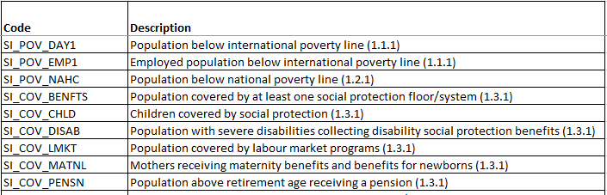
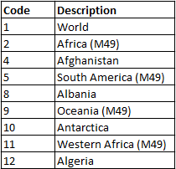
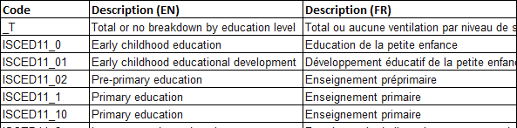
Code List: Some Examples
CL_SERIES
CL_AREA
CL_EDUCATION_LEV

Slide 23
SDMX Concepts and Code lists
Code lists provide a representation for concepts, in terms of Codes.
Codes are language-independent and may include descriptions in multiple languages.
Code lists must be harmonized among all data providers that will be involved in exchange.

Slide 24
Un-coded Concepts
Can be free-text: Any valid text can be used as a value for the concept.
  Footnote
Can have their format specified
  Postal code: 5 digits
  Last update: date/time

Slide 25
Representation of concepts in SDMX
Dimensions must be either coded or have their format specified.
  Free text is not allowed.
Attributes can be coded or un-coded; format may optionally be specified.

Slide 26
Data model so far…
Concept | ID | Role | Attachment | Representation
Indicator | INDICATOR | Dimension |  | CL_INDICATOR
Reference area | REF_AREA | Dimension |  | CL_AREA
Time period | TIME_PERIOD | Dimension |  | Date/time (YYYY)
Unit multiplier | UNIT_MULT | Attribute | Time series | CL_UNIT_MULT
Observation value | OBS_VALUE | Pr. Measure |  | Floating point number

Slide 27
Cross-domain Code Lists
Similar to cross-domain concepts, SDMX Statistical Working Group (SWG) develops and publishes Cross-Domain Code Lists.
When available, these are based on existing statistical classifications and contain codes from those classifications. Otherwise, codes are developed by the SWG.
These codes should be used whenever possible in SDMX exchange or dissemination. The code lists are often extended with country or organization-specific codes. For example, the global Reference Area code list is often extended with subnational reference area codes for national data dissemination.

Slide 28
Cross-domain Concepts and Code Lists: examples
Reference area: REF_AREA → CL_AREA
Sex: SEX → CL_SEX
Unit multiplier: UNIT_MULT → CL_UNIT_MULT

Slide 29
Generic cross-domain codes
Recommended Code Value | Recommended Code Description
_L | Local extension (can be used as a prefix)
_N | Non response
_O | Other
_S | Subtotal
_T | Total
_U | No data/unknown
_X | Not allocated/unspecified
_Z | Not applicable
These codes are recommended to be used in all code lists as appropriate.
* Source: Guidelines for the creation and Management of SDMX Code Lists

Slide 30
Data model so far: Code Lists
CL_INDICATOR
Code | Name
POP | Total Mid-Year Population
CL_AREA (partial)
Code | Name
AF | Afghanistan
AL | Albania
AQ | Antarctica
DZ | Algeria
AS | American Samoa
AD | Andorra
CL_UNIT_MULT
Code | Name
0 | Units
1 | Tens
2 | Hundreds
3 | Thousands
6 | Millions
9 | Billions

Slide 31
Data Structure Definition: summary
Concept Scheme
Reference
DSD
Reference
Code lists
Concept | Concept ID | Role | Attachment | Representation | Code list ID
Indicator | INDICATOR | Dimension |  | Code List | CL_INDICATOR
Reference area | REF_AREA | Dimension |  | Code List | CL_AREA
Time period | TIME_PERIOD | Dimension |  | YYYY
Unit multiplier | UNIT_MULT | Attribute | Time series | Code List | CL_UNIT_MULT
Obs. value | OBS_VALUE | Pr. Measure |  | Floating point number

Slide 32
SDMX Artefacts
While there are many types of artefacts, in almost all situations “SDMX Artefact” refers to a maintainable and versionable component of structural metadata.
  Concept Scheme
  DSD
  Code List
Note that e.g. an individual Code is not an artefact, since it can only exist and be transmitted as part of a Code List.

Slide 33
SDMX Artefact Identification and Versioning
Identification of SDMX Artefact consists of 3 fields: ID; Maintenance Agency; Version
Type | Name | ID | Maintenance Agency | Version
DSD | NA Main Aggregates | NA_MAIN | ESTAT | 1.11
DSD | NA Main Aggregates | NA_MAIN | ESTAT | 1.10
Concept Scheme | SDG Concept Scheme | SDG_CONCEPTS | IAEG-SDGs | 1.0
Code List | Reference area code list | CL_AREA | SDMX | 2.0

Slide 34
THANK YOU

