Slide 1


12a. SDMX Reference Infrastructure
Nadezhda VLAHOVA
Eurostat, Unit B.3
IT solutions for statistical production
European Statistical Training Programme (ESTP)
SDMX Basics course, 6-8 March 2018, Luxembourg

Slide 2
Table of Contents
Objectives
What is the SDMX-RI
How to implement the SDMX-RI (prerequisites, architecture, components and functionalities)
Why to use the SDMX-RI
SDMX-RI in action

Slide 3
1. Objectives
Understand what is the SDMX-RI and its architecture
Why the SDMX-RI can help you

Slide 4
WHYs
Do you have a sustainable solution for dissemination or do you want to build one?
Are you responsible for data reporting or exchange or dissemination?
Are you expert in SDMX?
Do you see SDMX as a challenge?
Do you want to have your data in SDMX format easy and at minimal cost?
Do you want always to understand the data from others?
Answers: Yes – Yes – No - Yes/No – Yes - Yes

Slide 5
2 What is SDMX-RI
Software for SDMX data provision (dissemination and reporting)
Set of pick-and-choose reusable building blocks, allowing the data provider to expose SDMX data to the external world
Designed to translate internal data storages into SDMX compliant data files using mappings
Uses SDMX standards specifications (v.2.0 and v2.1), including the one for Web Services

Slide 6
2 What is SDMX-RI
Developed to simplify the exchange of data
Provides standard software and components, allowing individual statistical organizations to interact and exchange their data using the same software and methodology
Modular and extendable approach (modify, use part or the entire infrastructure) to suit different purposes
WS is developed in both Java and .NET

Slide 7
3. Prerequisites
A web application server (WebLogic, Tomcat, IIS)
.NET Framework 4.0 (or higher) / a JAVA environment
A database server (Oracle, Sql server, Maria DB)
Windows environment (the WS is available in Java but the tools are .net based)
Data stored in a dissemination database
Available SDMX artefacts (DSDs, DFs, Codelists, etc.)
For details, consult the installation manual of the tool

Slide 8
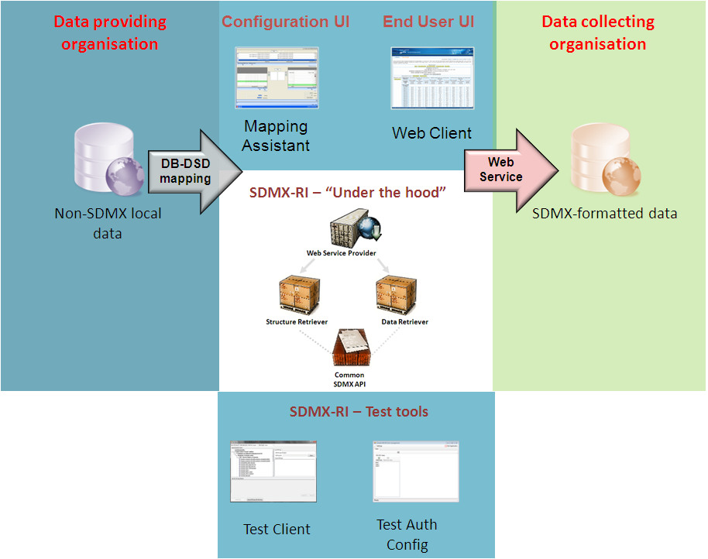
3. SDMX-RI architecture

Slide 9
3. SDMX-RI Components
Mapping Assistant
Test Client
NSI Web Service
NSI Client
Test Auth Config

Slide 10
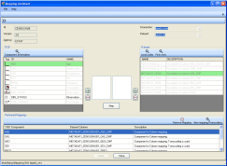
SDMX – RI - Mapping Assistant
  Stores the SDMX structures agreed for the data exchange process
  Allows users to define subsets of data to be disseminated
  Creates and stores mappings between the internal data structure and SDMX concepts
  (e.g. My_column_A = AGE)
  Creates and stores mappings between the internal classifications and SDMX codelists
  (e.g. My_code_AB = Y_LT15)
Result:
Control the exposed data
Preview the data in SDMX format
Identify errors

Slide 11
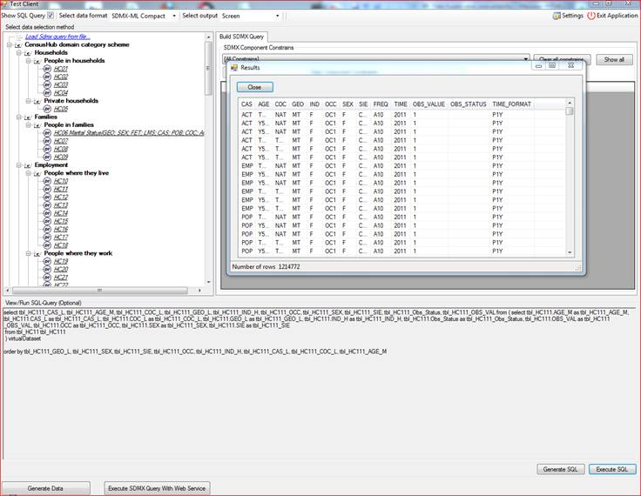
SDMX – RI - Test Client
  Allows users to view and extract data in SDMX format, using the mappings defined in the Mapping Assistant tool
  extract data directly from the dissemination database
  extract data using a web address (web service)
Result:
Allows to test the dissemination process and SDMX compliance
Create custom extraction
Identify errors
Extract data in different formats

Slide 12
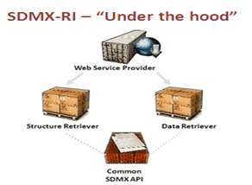
SDMX – RI – NSI/Web service
  No graphical user interface
  Invisible for the user modules controlling the incoming data requests
  Retrieving SDMX structure and mappings
  Retrieving data from the dissemination database
  Generating data response messages
  Sending data in SDMX format
Result:
  Data are made available to different data consumers via internet

Slide 13
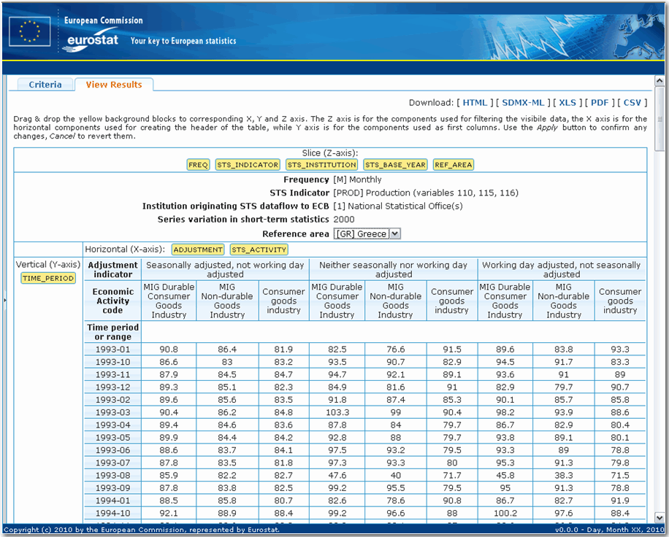
SDMX – RI - Web Client
  Allows users to view and extract data in SDMX format, using the mappings defined in the Mapping Assistant tool
  Provides user friendly interface for even not experienced users
  Can extract data using a web address (web service)
Result:
  Allows to test the data dissemination process and SDMX compliance
  Create custom extraction
  Identify errors
  Extract data in different formats

Slide 14

SDMX-RI vs SMDX Converter
Compliance workflow
NSI
SDMX codes
Extract files
Transform file
SDMX file
Dissemination/Transmission
SDMX Converter
NSI software
SDMX Converter
Processing for sending
EDAMIS
SDMX-RI
Processing
for sending
EDAMIS
Mapping Assistant
Test client
NSI client
Non-SDMX local data
NSI Web service
HUB
NSI development
NSI software
EDAMIS
Eurostat tools
NSI developed software
Notes:
Pilot A2 Automated generation of SDMX data files from national SBRs for input to EGR (HR, LV)
Pilot A3 Automated transfer (pulling) of data from national SBRs for input to EGR (BG, NL, IT*)

Slide 15
SDMX-RI - identified advantages
  Covers dissemination and reporting requirements
  Facilitate the SDMX compliance phase
  Limited/no change of the existing environment, production or dissemination systems
  Limited/no need for adaptation
  Open source
  Reusable modules/installations through well-defined APIs
  Exhaustive and clear documentation
  Fully supported by Eurostat and used within and outside ESS
  IT Trainings available

Slide 16
SDMX-RI releases and support
Release schedule
  1 major release per year & tool
Formal overlapping release cycles
  Collection and analysis of user requirements
  Design, implementation and documentation
  User testing, bug-fixing and release
Download
  SDMX Info Space

Slide 17
THANK YOU FOR YOUR ATTENTION!
QUESTIONS?
DEMO

