Slide 1
DSD Constructor, more than just DSDs
ILO Department of STATISTICS

Slide 2
Overview
DSD Constructor – with updates on the latest features
Introduction
Modularized editors
Modality
Local registry
Direct connection to .Stat Suite Data Lifecycle Manager (DLM)
Multilingual
Embedded translation service using Google and DeepL API
Data Modeler (Beta)
Short Demo

Slide 3
DSD Constructor
A simple standalone tool, which is able to create and edit DSD/dataflow and all their related artefacts.
Free to use, free first-level support
Easy to install and update – ClickOnce
SMART companion
Online connection to any SDMX registry
Annotations management
Support up to 3 languages for names and descriptions
Notes:
DSD Constructor, a simple desktop application, originally designed for the creation and maintenance of DSDs and its related child artefacts. It has gained some popularity since first introduced back in 2018.

Slide 4
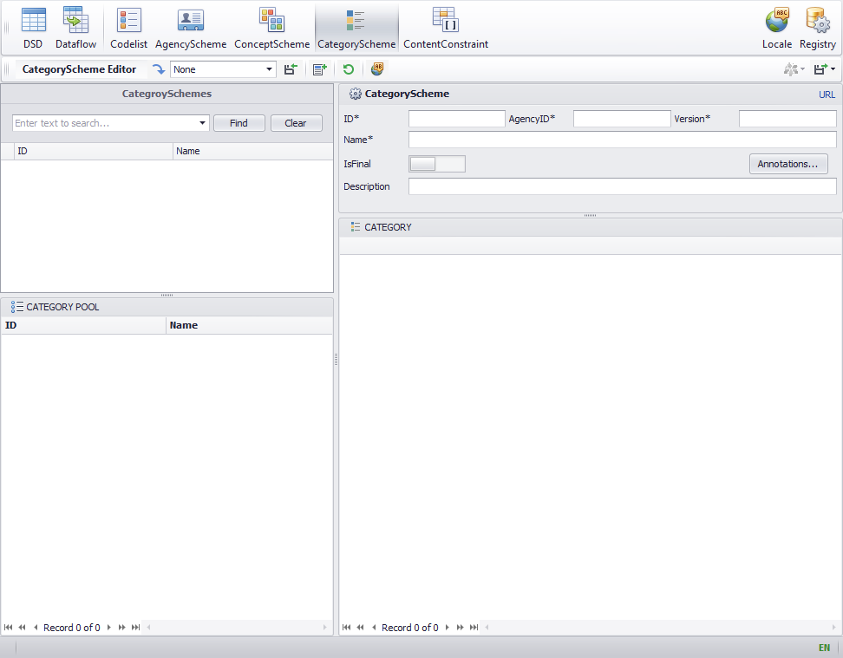
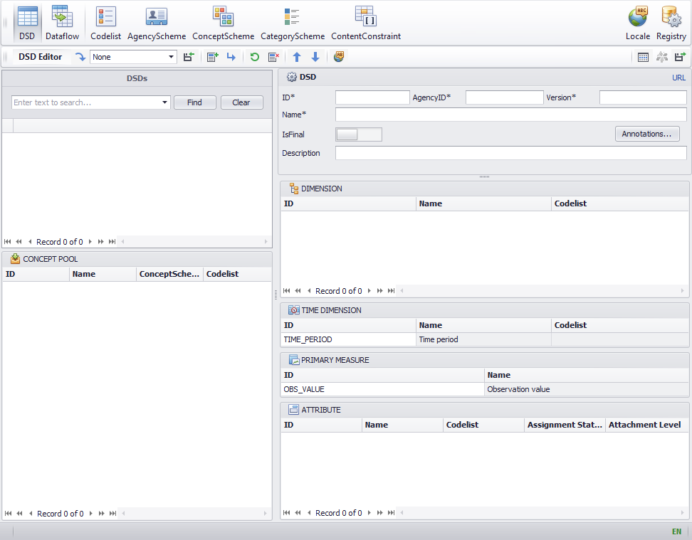
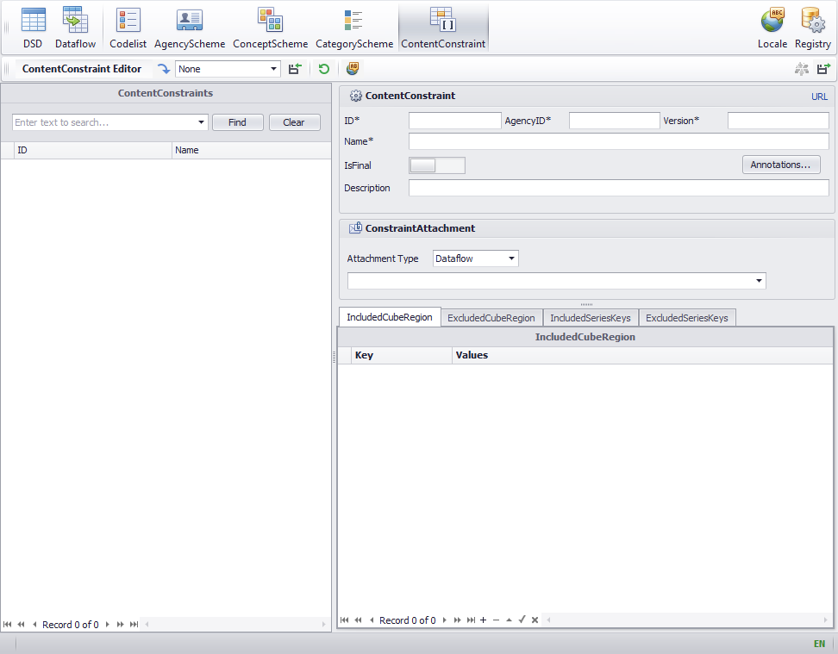
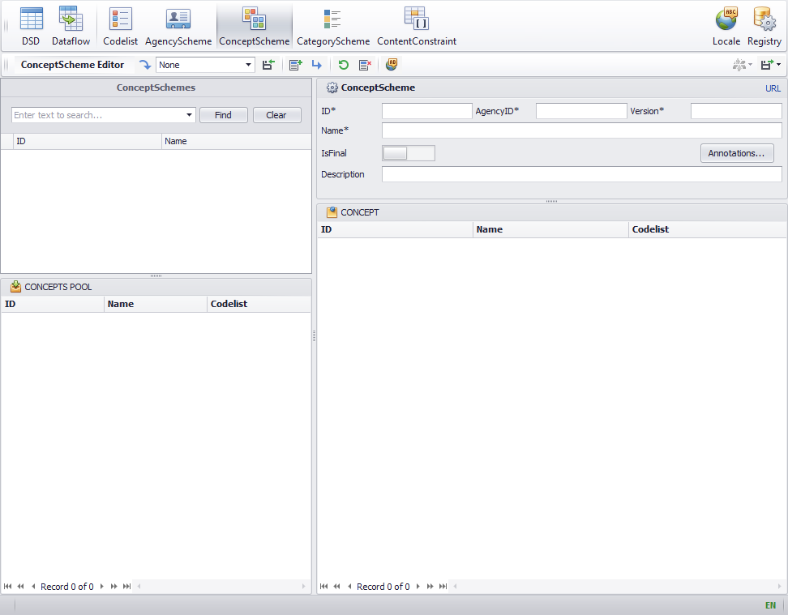
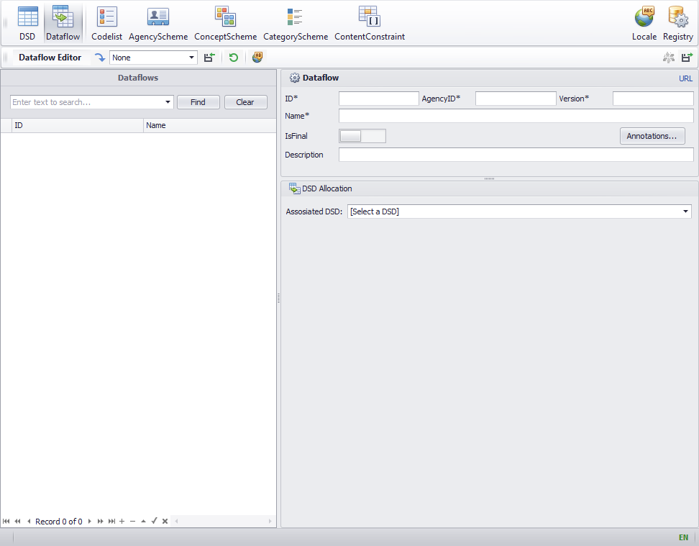
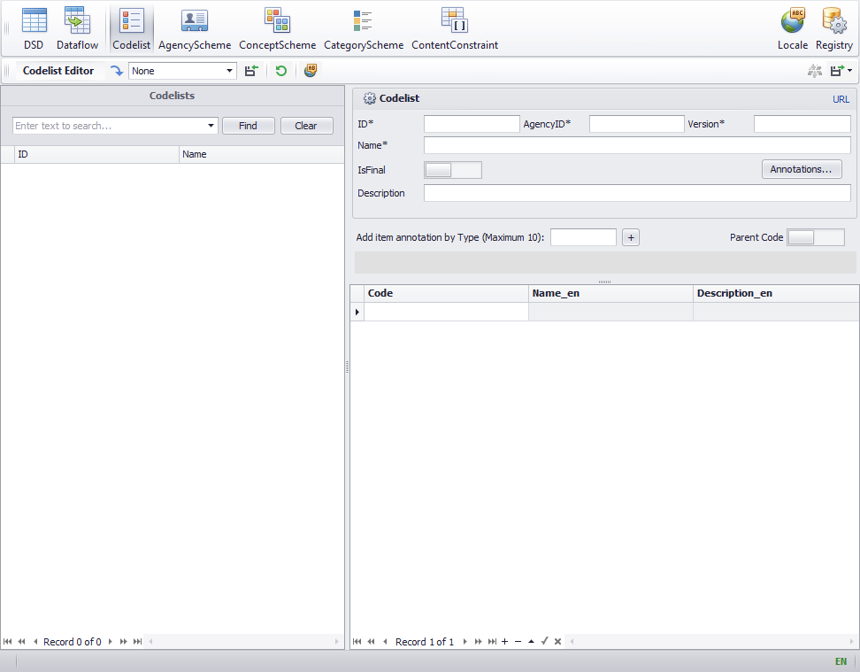
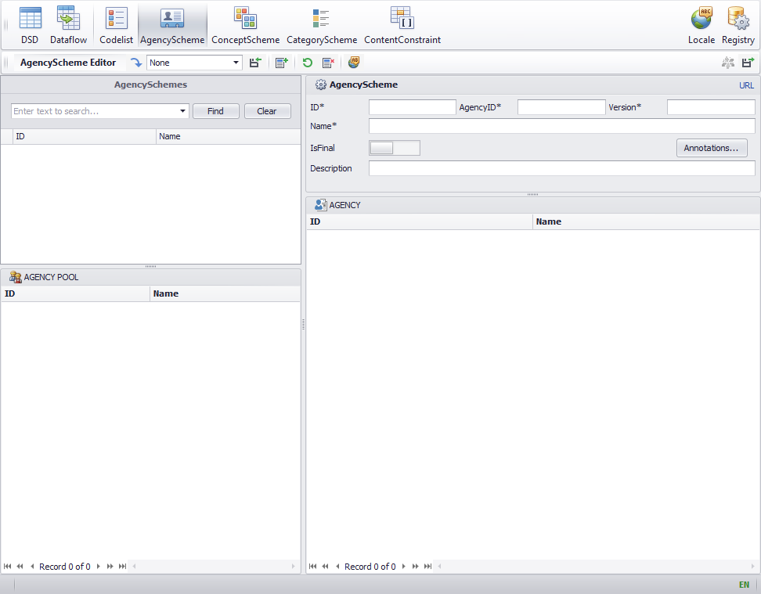
Modularized Editors
For general SDMX artefact management
DSD
Dataflow
Codelist
AgencyScheme
ConceptScheme
CategoryScheme
ContentConstraint
Notes:
What can DSD Constructor do for now? The short answer is More than just DSDs.
In order to fulfil the growing demands for the general SDMX artefact management, we have further expanded the Constructor with new modularized editors.

Slide 5
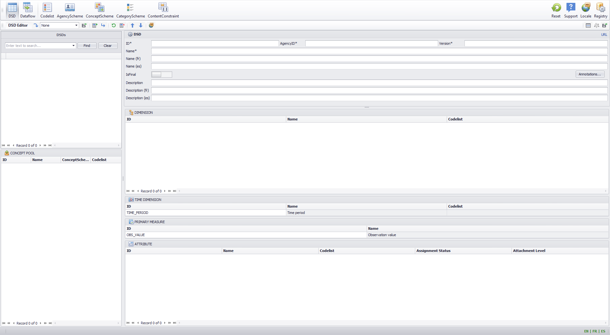
Coherent Design
2. Satellite menu. Language, registry configurations...
1. Top menu. Click to switch different artefact Editors.
4. Editor export menu. Preview, push or export.
3. Editor input menu. Mouse over button to see its function.
5. List of items under the selected registry. Double-click any item to load details.
7. Artefact-specific subitems. For example in DSD Editor, Dimensions, Primary Measure and Attributes are listed for editing.
6. General properties panel. ID, AgencyID, Version, IsFinal, Annotations, Names and Descriptions.
8. Working-on-process subitem pool. A staging area to add/load subitems to work here first, and then drag&drop to the corresponding region.

Slide 6
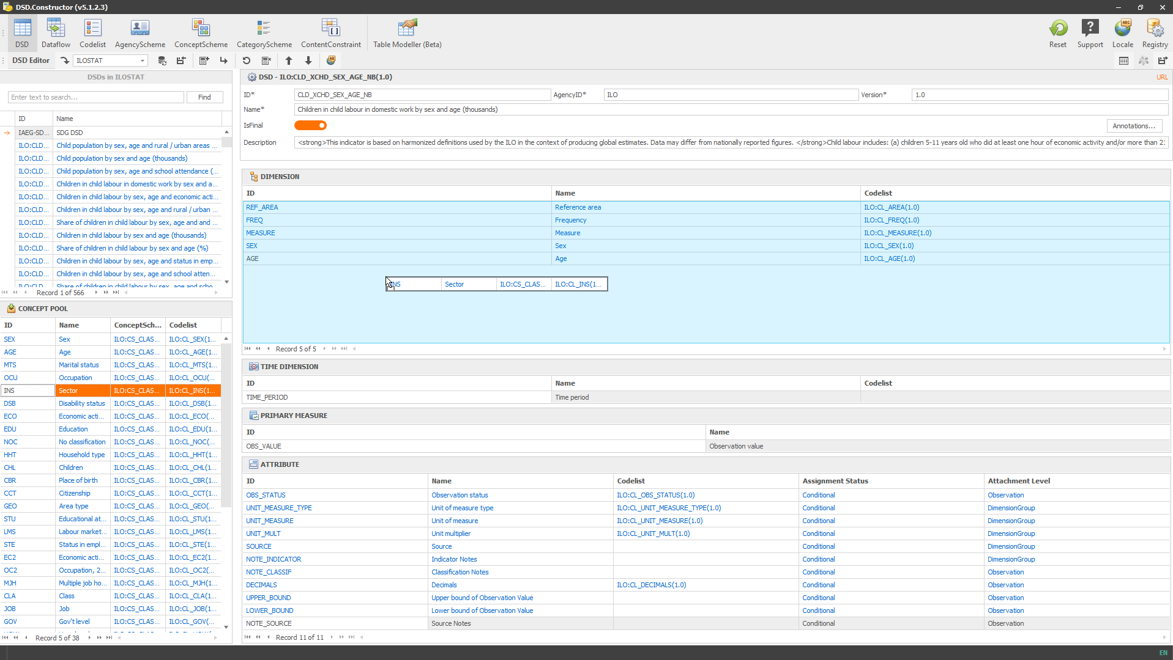
Modality
Select the Editor
Upload, load existing artefacts or create a new artefact
Double-click
Any item in the list to load details
Any item to modify details
Drag & drop
From/to the item pool
Between subitems, i.e., from Dimension to Attribute
Items insides table modeler
Copy & paste
Bulk load codelists and concepts from Excel
Codelist items
After the editing finished, export or push directly to DLM
Notes:
Using .Stat suite post API, the Constructor allows the user to directly connect to .Stat Suite DLM.

Slide 7
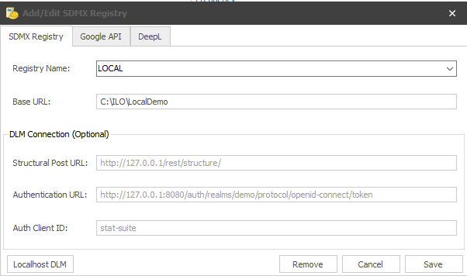
Local Registry
Instead of putting a base URL, a local folder path can
also be used to create a “local registry”
Any SDMX-ML files are processed and can be loaded
just as a standard registry
The advantage to save files in a local registry is to allow
cross-references among artefacts

Slide 8
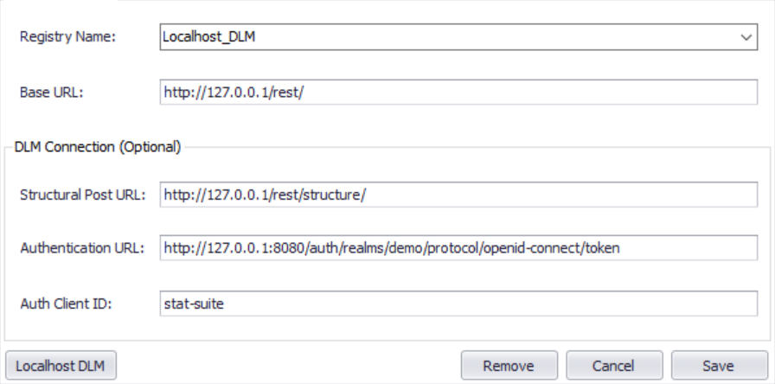
Direct Connection to .Stat Suite DLM
Using .Stat Suite post API
View, add and edit structures
Return DLM structure validation message
Required connection input
Structural post URL
Authentication URL and Client ID
Login credential
Notes:
Using .Stat suite post API, the Constructor allows the user to directly connect to .Stat Suite DLM.

Slide 9
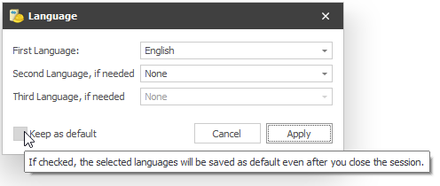
Multilingual
Allow up to 3 languages
Click Button “Locale” or bottom-right language label
to set up
Save a default language setting to avoid configuring
it each time starting a new session
Mainly, it is available for
Names
Descriptions
Annotation texts

Slide 10
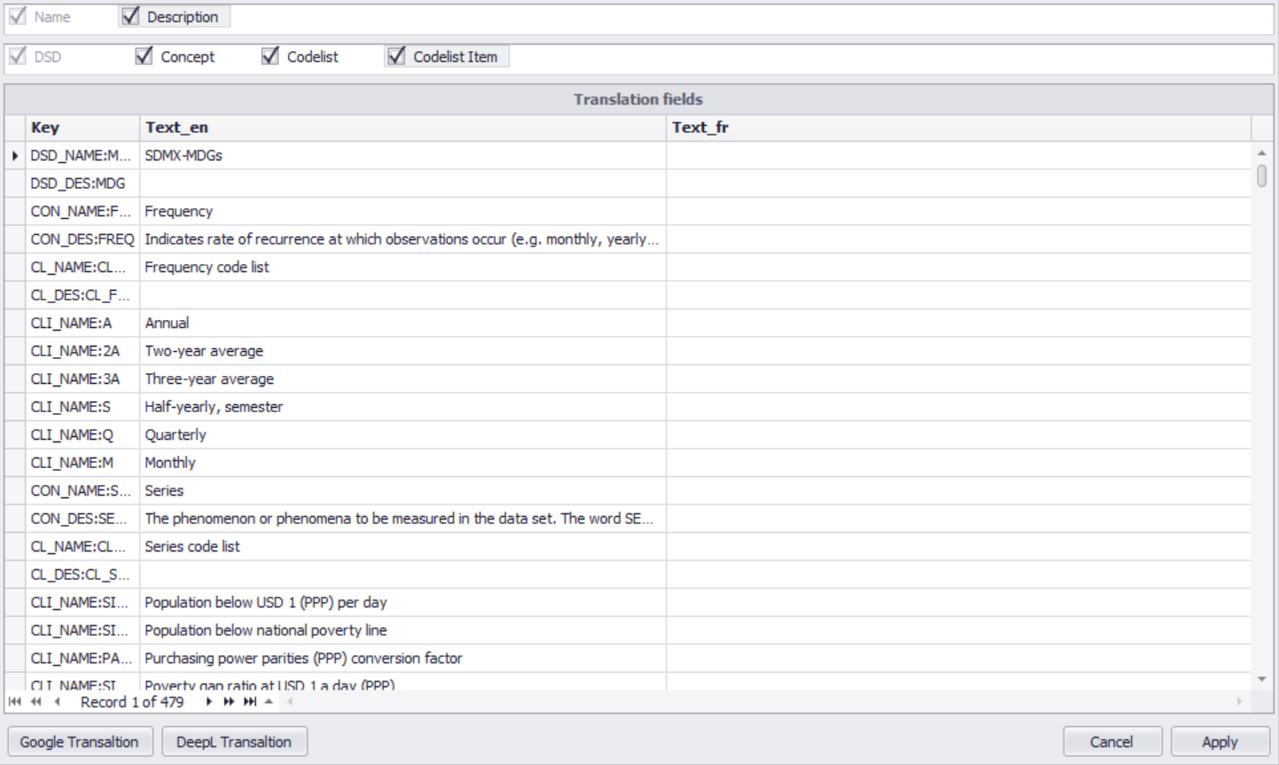
Embedded Translation Service
Translate names and descriptions
Inline translation using Google or DeepL API
Copy/paste fields to/from a local Sheet for optional
manual translation
​Distribute directly the translations back into the fields
Service specification:
Google service account specified in a JSON file
DeepL API key
Use cases
Translate an existing SDMX structure
Translate while creating a SDMX structure

Slide 11
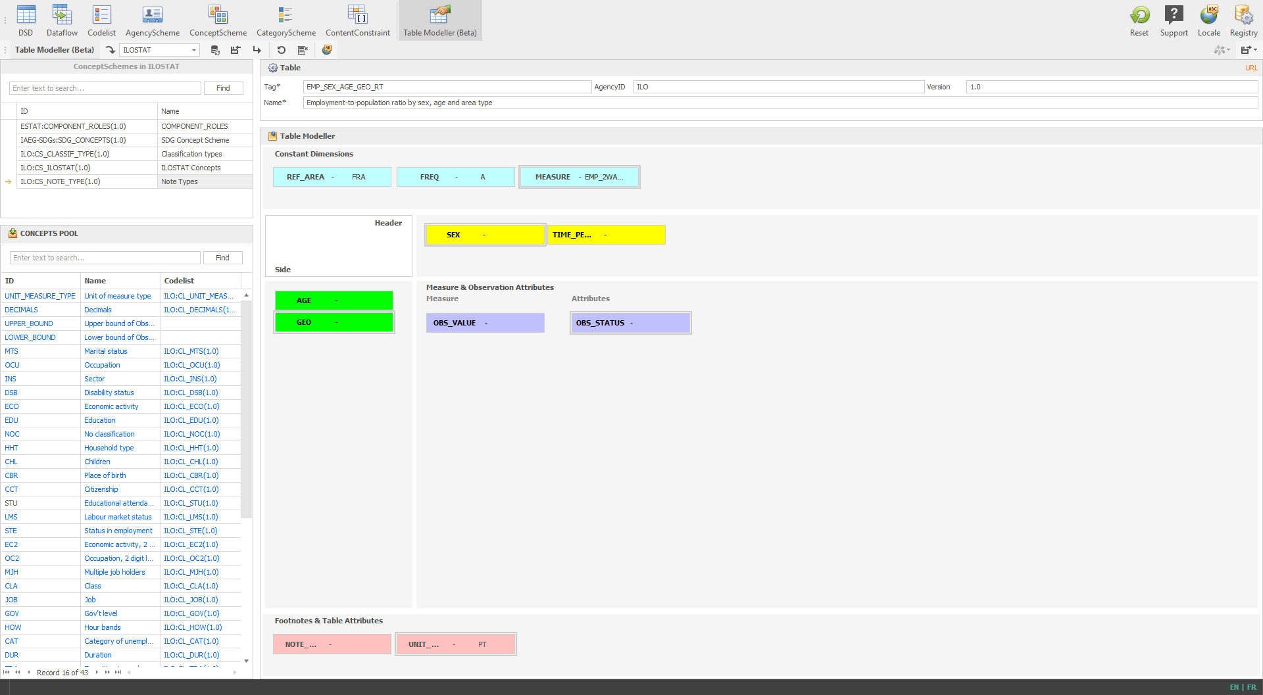
Table Modeller (Beta)
Load concepts in the concept pool
Drag & drop concepts into the corresponding
table area
Double-click the concept to assign any code
constraints. For example, assign “A” for
dimension “FREQ”
Enter the basic properties (ID, Name, .etc)
Save the joint outputs
Data flow
DSD
Content Constraint

Slide 12
Short Demo

Slide 13
Thank you!
ILO Department of STATISTICS
sdmx.support@ilo.org

