Slide 1


UN Demographic Yearbook data and metadata collection and dissemination
26 February 2025
Statistics Division

Slide 2
Contents
    The United Nations Demographic Yearbook
      Purpose and mandate
      Data and metadata collection
      Demographic Yearbook questionnaires
      Demographic Yearbook (UNSD demographic statistics) database and data dissemination

Slide 3
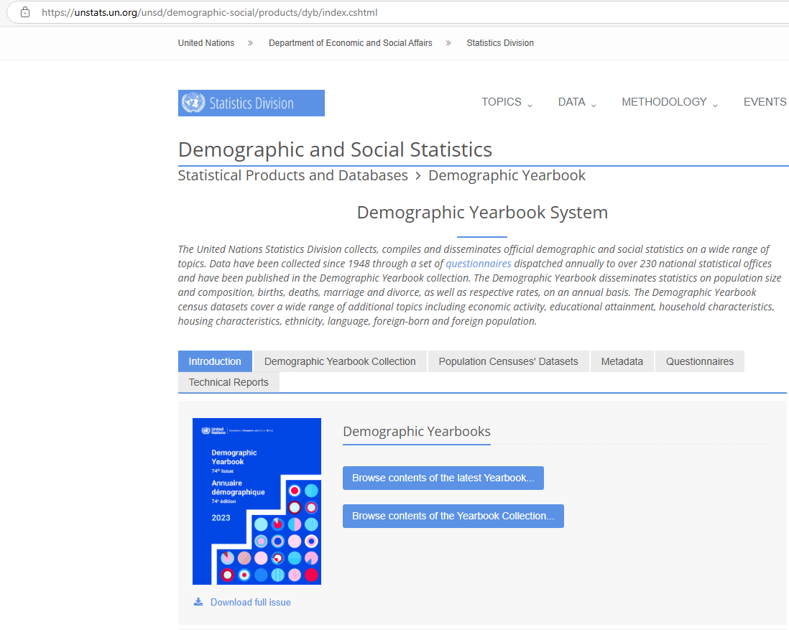
United Nations Demographic Yearbook (DYB)
Mandated by ECOSOC in 1947
… a publication of demographic year-book, containing
regular series of basic demographic statistics, comparable
within and among themselves, and relevant calculations of
comparable rates …
  The first issue
  Demographic Yearbook 1948
  Published every year since 1949
  https://unstats.un.org/unsd/demographic-social/products/dyb/index.cshtml

Slide 4
DYB Data and metadata collection
Initiated in March every year
Official national population estimates (annually): data and metadata
Vital statistics (annually): data and metadata
International travel and migration statistics (annually)
Initiated in July/August every year
Population and Housing Censuses data and metadata: upon conducting of a census and availability of census results
The data are collected from the National Statistical Offices worldwide
https://unstats.un.org/unsd/demographic-social/products/dyb/index.cshtml#questionnaires

Slide 5
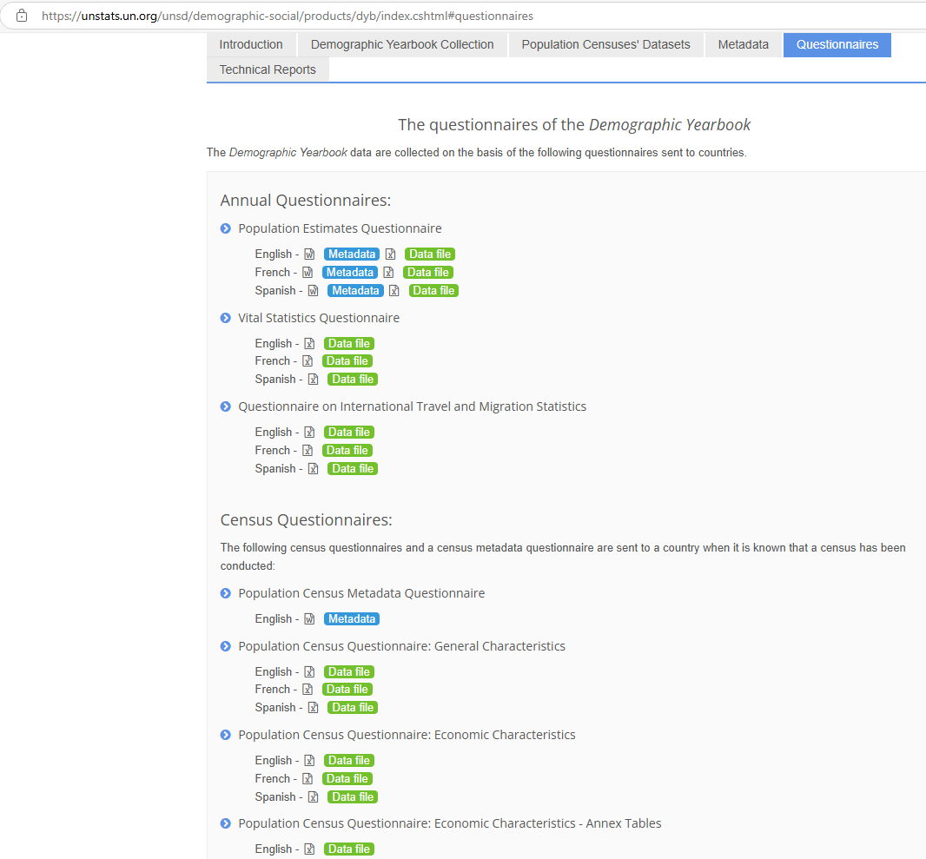
Demographic yearbook Annual questionnaires
Population Estimates Questionnaire (data and metadata)
Vital Statistics Questionnaire (data and metadata)
Questionnaire on International Travel and Migration Statistics

Slide 6
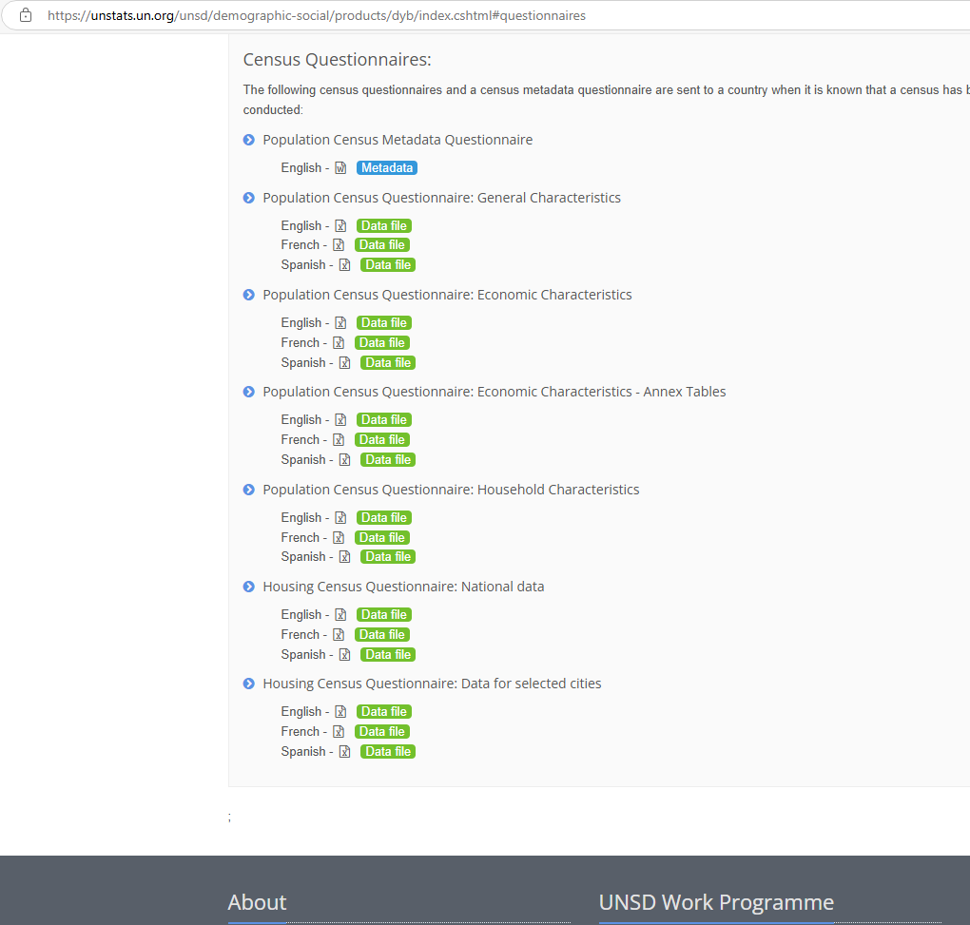
Demographic yearbook census questionnaires
Population Census metadata questionnaire
Population Census Questionnaire: General Characteristics
Population Census Questionnaire: Economic Characteristics
Population Census Questionnaire: Household Characteristics
Housing Census Questionnaire: National data
Housing Census Questionnaire: Data for selected cities

Slide 7
Data and metadata dissemination
The annual edition of Demographic Yearbook – published in October/November every year, the latest one UN Demographic Yearbook 2023
Population estimates, Vital statistics, Migration flows, Population and Housing Censuses data - published and updated twice a year (February and August) Demographic Statistics datamart of UNdata portal
All metadata questionnaires are published and updated twice a year (February and August)

Slide 8
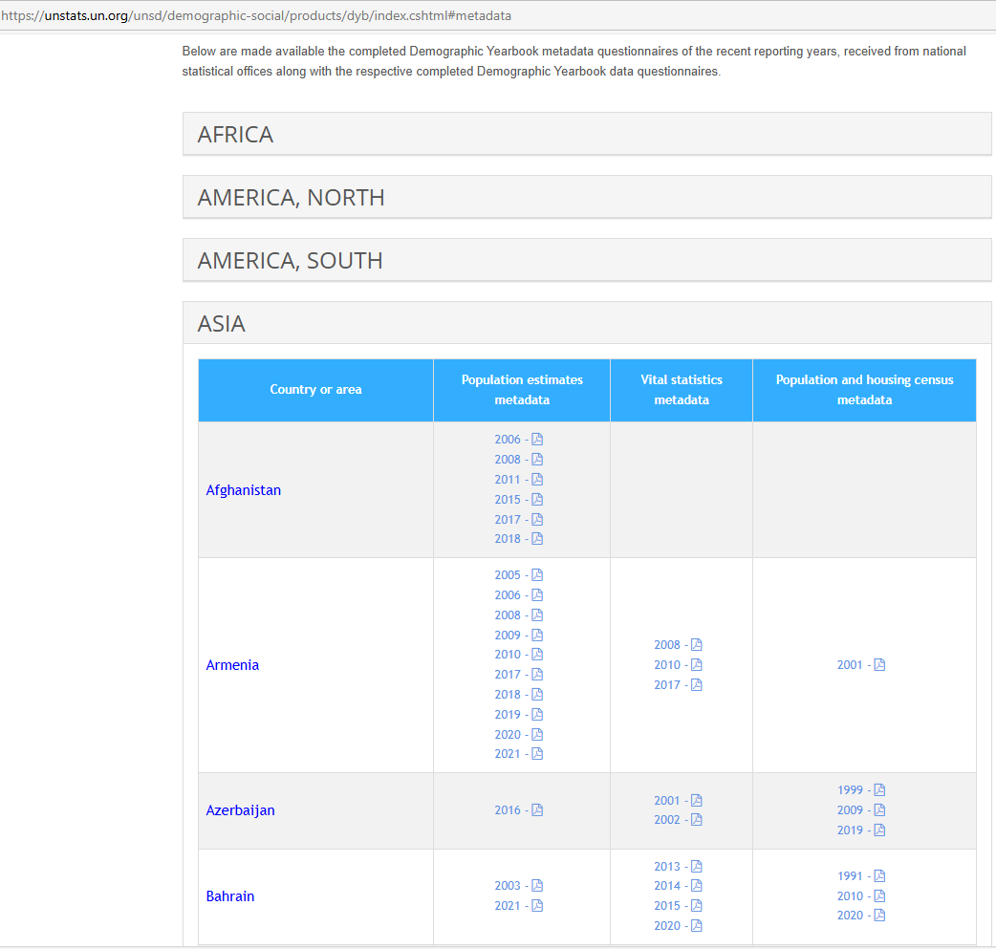
*A snapshot of metadata for illustration

Slide 9

Thank you.

